Slide 1
Today’s Agenda
Arrays
Arraylist
Set
Exception handling

Slide 2
Arrays: Array is a collection of similar data type.
Array of Integer
Array of String
Array of char
Array of double and so on

Slide 3
Array types:
Single dimentional Array:
Syntax:
Datatype arrayname[]=new datatype[size]
Int arr[]=new int[5]
Arr[0]=10;
Arr[1]=20;

Slide 4
Two dimentional Array:
Syntax:
Datatype arrayname[][]=new datatype[size][]
Int arr[][]=new int[3][2]
Arr[0][0]=10;
Arr[0][1]=20;
Arr[1][0]=20;
Arr[1][1]=20;

Slide 5
Limitation:
Limitation of type-Fixed type
Limitation of size-Fixed size
To overcome this we have list, ArrayList and set

Slide 6
Collection: It is dynamic data structure
Collection in java: is a framework that provides an architecture to store and manipulate the group of objects.
All the operations that you perform on a data such as searching, sorting, insertion, manipulation, deletion etc can be performed by java collections.
Java collection framework provides many interfaces(set,list,queue,deque etc) and classes(Arraylist,Vector,linkedlist,TreeSet etc

Slide 7
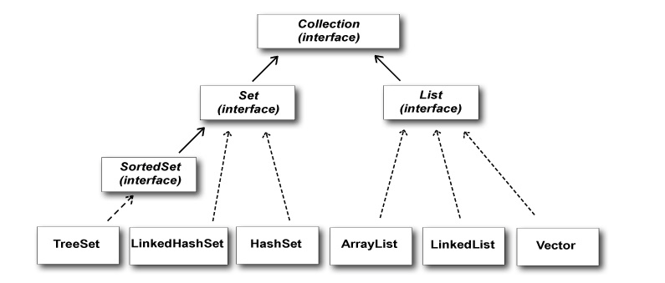
__________ :Extends -----------: Implements

Slide 8
List and Arraylist: List is an interface and Arraylist is a class and implements list.
Java Arraylist class uses a dynamic array for sorting.
Java Arraylist class can contain duplicate elements.
Java Arraylist maintains insertion order.
Java Arraylist allows random access because array works at the index basis.
Syntax:
Arraylist obj1=new Arraylist();
Obj1.add(65655)
Obj1.add(“xyz”)
Obj1.get(i)

Slide 9
Generic in Collection:
Java generic collection allows you to have only one type of object in collection.
Non generic Arraylist
Arraylist al=new Arraylist();
Generic Arraylist
Arraylist <String> al=new Arraylist<String>();
In generic collection, we specify the type in angular braces.

Slide 10
Program:
public class MyClass { public static void main(String[] args) { ArrayList<String> cars = new ArrayList<String>(); cars.add("Volvo"); cars.add("BMW"); cars.add("Ford"); cars.add("Mazda"); for (int i = 0; i < cars.size(); i++) { System.out.println(cars.get(i)); } } }

Slide 11
Set Interface:
Set is interface in java which extends collection interface.
Set does not allow duplicate values
Set is unordered collection
Can’t be accessed using index

Slide 12
Methods of Set:
HasNext(): The hasNext() is a method of Java Scanner class which returns true if this scanner has another token in its input.
Iterator(): Returns an iterator object for the collection.
Set is implemented by HashSet, LinkedHashSet, and TreeSet.
Syntax:
Set<data-type> s1 = new HashSet<data-type>();

Slide 13
Program:
public static void main(String args[]){
//Creating HashSet and adding elements
HashSet<String> set=new HashSet<String>();
set.add("Ravi");
set.add("Vijay");
set.add("Ravi");
set.add("Ajay");
//Traversing elements
Iterator<String> itr=set.iterator();
while(itr.hasNext()){
System.out.println(itr.next());
}
}

Slide 14
Exception :
In Plain English, exception is abnormal condition.
In Java also exception is abnormal scenario which will stop the execution of current program.
In Technical words Exception is class.

Slide 15
Exception Handling:
Exception handling is a way to handle runtime/complie time errors such as IO Exception,Arithmatic exception and so on.
Main reason of exception handling is to maintain the normal flow of the application.

Slide 16
Common Scenarios of Java Exceptions
1) A scenario where ArithmeticException occurs
If we divide any number by zero, there occurs an ArithmeticException.
int a=50/0;//ArithmeticException
2) A scenario where NullPointerException occurs
If we have a null value in any variable, performing any operation on the variable throws a NullPointerException.
String s=null;
System.out.println(s.length());//NullPointerException
3)A scenario where ArrayIndexOutOfBoundsException occurs
If you are inserting any value in the wrong index, it would result in ArrayIndexOutOfBoundsException as shown below:
int a[]=new int[5];
a[10]=50; //ArrayIndexOutOfBoundsException

Slide 17
Types of Java Exceptions:
1) Checked Exception
Error are known as checked exceptions e.g. IOException, SQLException etc. Checked exceptions are checked at compile-time.
2) Unchecked Exception
Unchecked exceptions are not checked at compile-time, but they are checked at runtime.
ArrayIndexOutOfBoundsException etc.
3) Error
Error is irrecoverable e.g. OutOfMemoryError, AssertionError etc.

Slide 18
There are 4 keywords which are used in handling exceptions in Java.
Keyword | Description
try | The "try" keyword is used to specify a block where we should place exception code. The try block must be followed by either catch or finally. It means, we can't use try block alone.
catch | The "catch" block is used to handle the exception. It must be preceded by try block which means we can't use catch block alone. It can be followed by finally block later.
finally | The "finally" block is used to execute the important code of the program. It is executed whether an exception is handled or not.
throws | The "throws" keyword is used to declare exceptions. It doesn't throw an exception. It specifies that there may occur an exception in the method. It is always used with method signature. Used to handle checked exception. Thread.sleep(),fileinputstream

Slide 19
Syntax of Try Catch:
Try{
//code that may throw exception
}
Catch(Exception_Class_name ref)
{
}

